Slide 1
How to order a second copy of an e-book (suggested method)
Yoel Kortick
Senior Librarian

Slide 2
Background
Ordering the second copy

Slide 3
Background
In the situation described here the library has purchased an e-book and the order (POL) for the e-book is closed.
At a later time the library purchases another “copy” of the e-book.
We will not elaborate here on what another “copy” means, and different institutions have different nuances of the definition.
In our example the additional e-book copy may be “access for one or more additional concurrent users to an electronic portfolio, purchased from the same vendor as the original POL”.

Slide 4
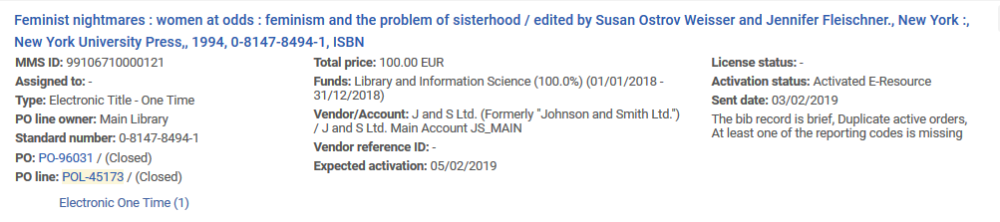
Background
The following order, POL-45173, for title “Feminist nightmares” is closed.
It is for an e-book. The POL is type “Electronic Title – One Time”

Slide 5
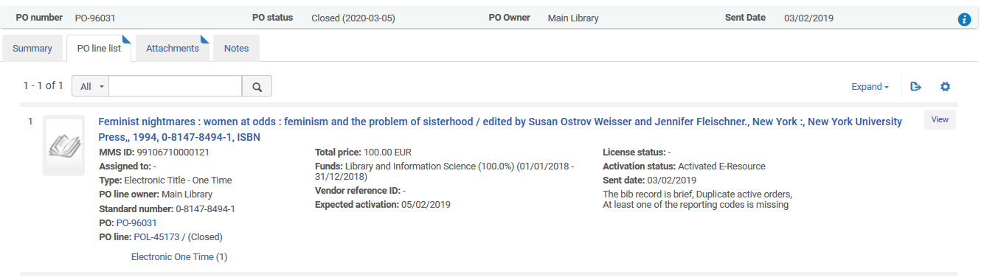
Background
It is connected to closed invoice PO-96031

Slide 6
Background
Now the institution decides to purchase an additional electronic copy of title “Additional nightmares” from the same vendor.

Slide 7
Ordering the second copy

Slide 8
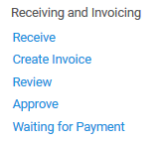
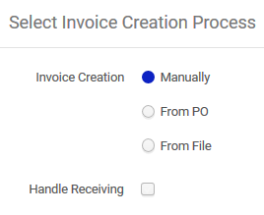
Ordering the second copy
Manually create an invoice

Slide 9
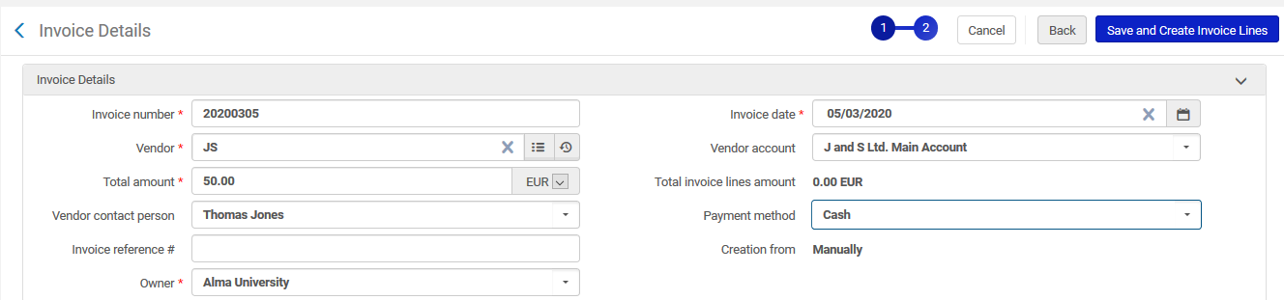
Ordering the second copy
Fill in invoice details (vendor, price of second copy, etc.) and then create an invoice line
Same vendor as the originally ordered e-book
Price of additional “copy” of the e-book

Slide 10
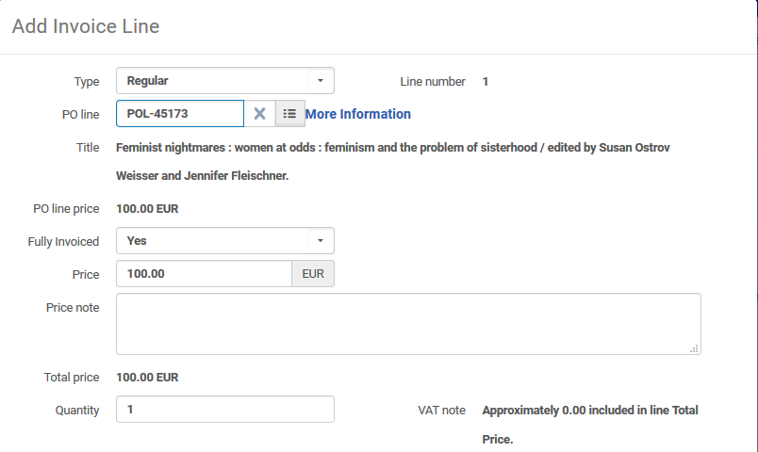
Ordering the second copy
From the invoice line we will search for the original order (POL-45173)

Slide 11
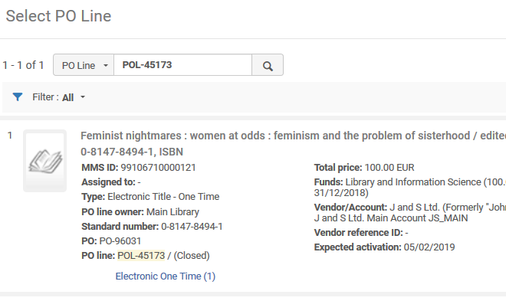
Ordering the second copy
Note that we are linking the invoice line to a closed order. By default the POLs are filtered by ‘Active’ so you will need to change the filter to ‘All’ to find and connect this POL in the pickup list.

Slide 12
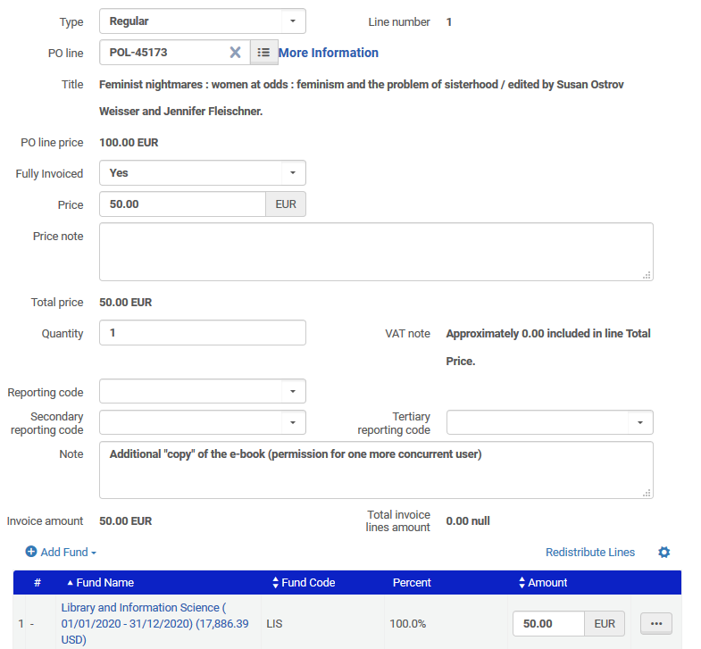
Ordering the second copy
Change the price (of the invoice line) to be the price of the additional “copy” of the e-book and add a note.
The additional “copy” costs 50.00 EUR

Slide 13
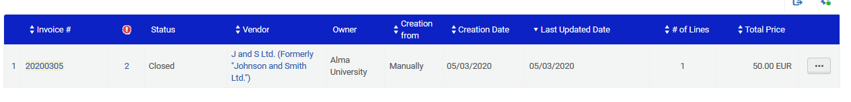
Ordering the second copy
Pay and close invoice as you would for any invoice

Slide 14
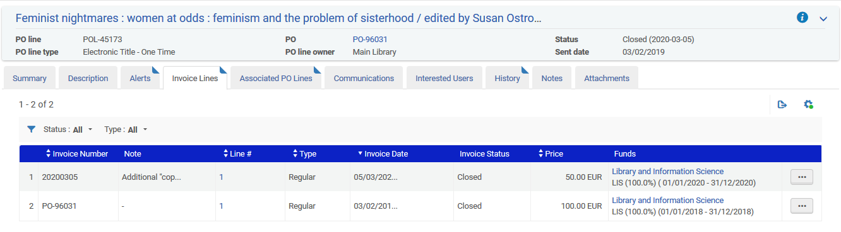
Ordering the second copy
See that the additional charge for the additional “copy” of the e-book got linked to the original order

Slide 15
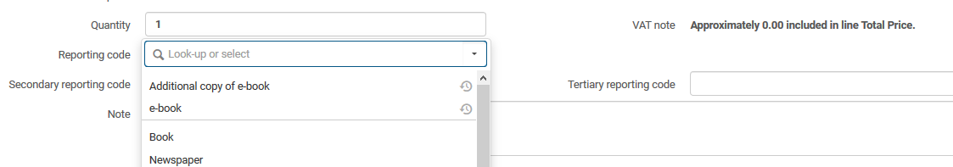
Ordering the second copy
Note that if this is a frequent occurrence you could create a reporting code for it and use it in the invoice line.
It will then be able to retrieve all such occurrences easily in Alma Analytics.

Slide 16
Yoel.Kortick@exlibrisgroup.com

